Slide 1
Time Series Forecasting
Done By: Toh Kien Yu (P2222291)
Background Research
I will be forecasting Gas, Electricity and Water Consumption for this project. 1. Forecasting gas consumption is essential for setting up and running of a sustainable system. 2. Forecasting electricity is important is crucial as it serves as a foundation to make decisions in power sector planning. 3. Forecasting water consumption is also important to ensure people do not face service interruptions are able to maintain an affordable rate while being dependable. Overall, forecasting allows us to better plan and make decisions when managing our resource.

Slide 2
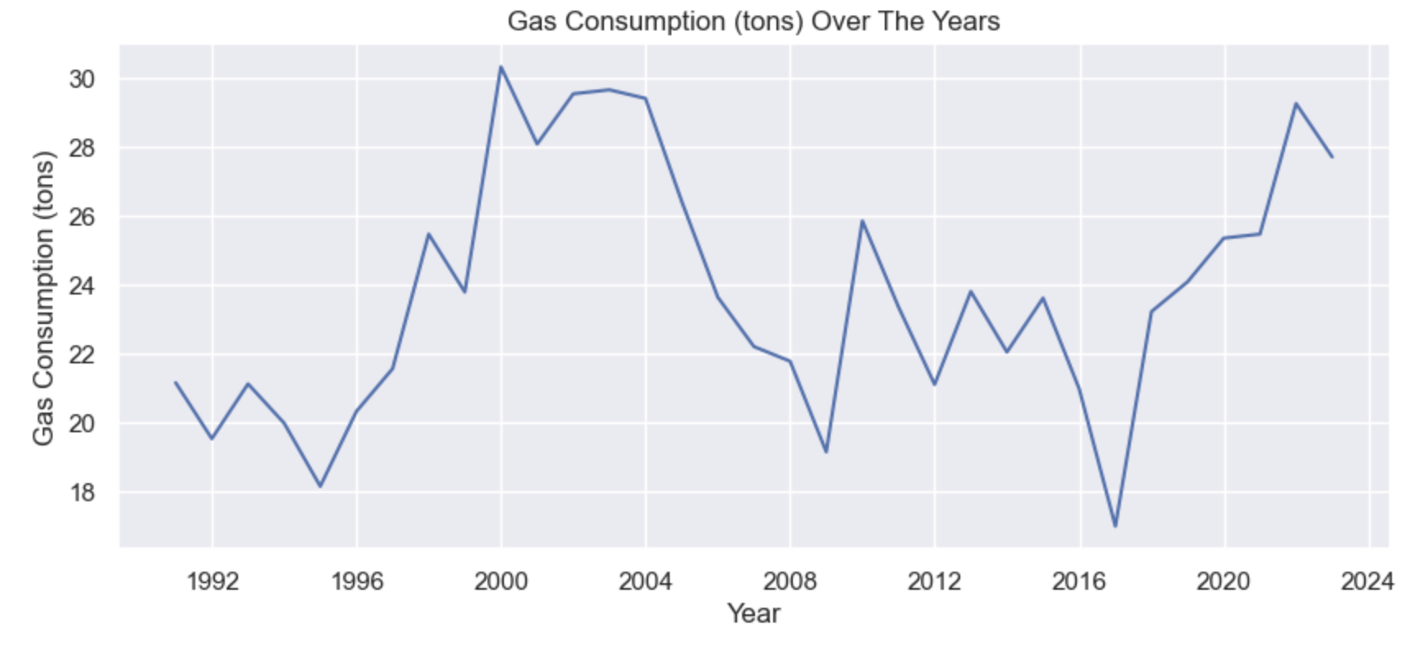
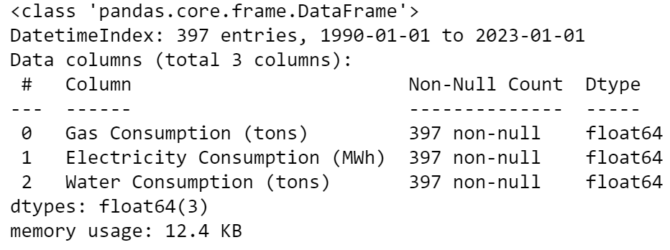
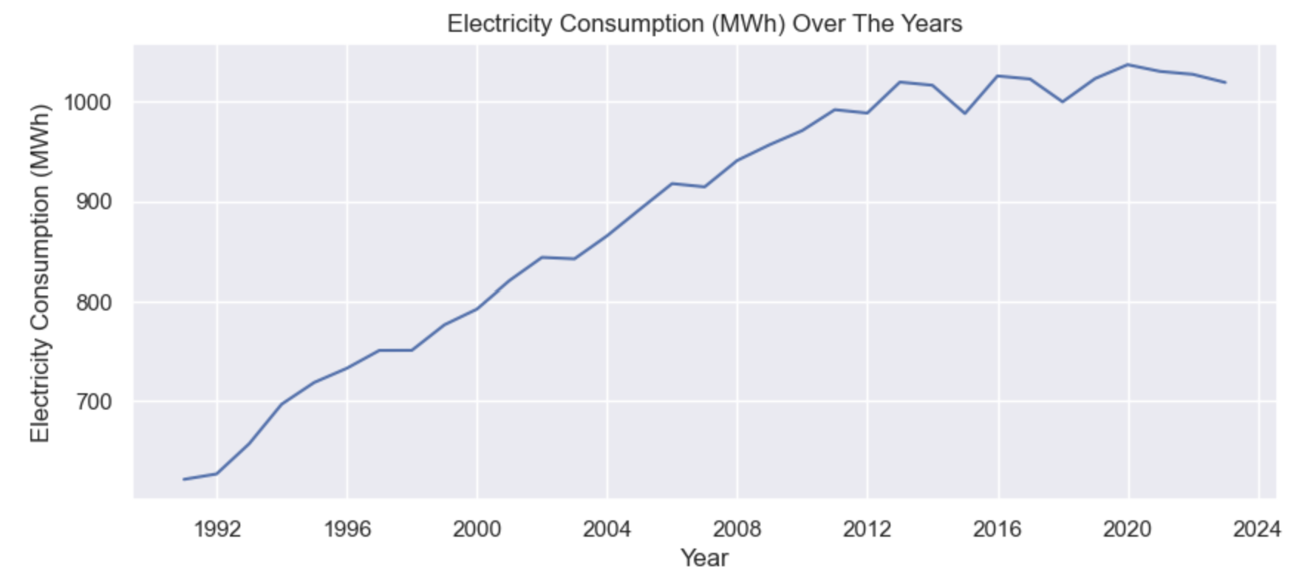
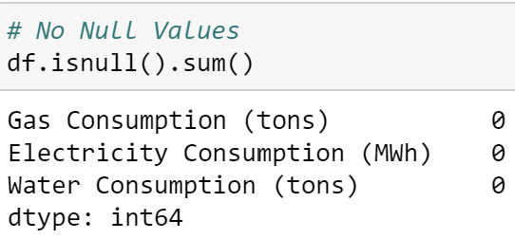
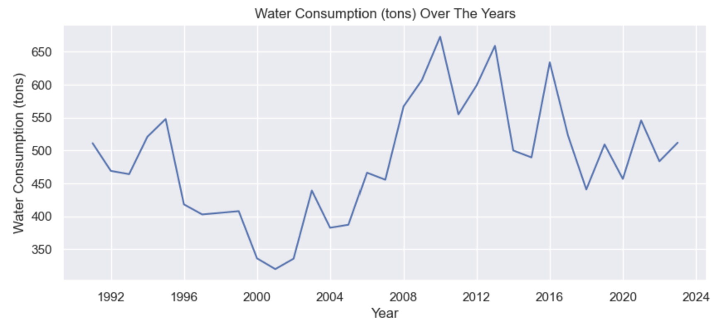
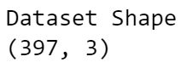
Nature of Dataset
Data Exploration
Numeric Data
Gas Consumption (tons)
Electricity Consumption (MWh)
Water Consumption (tons)
Categorical Data
1. DATE
There is an increase of about 7 tons of gas consumption over the years with fluctuations occurring during this period.
Electricity Consumption has been increasing over the years which can be possibly attributed to the global population increase.
While there is a general fall in water consumption, fluctuations occurred greatly where water consumption peaked at 675 tons in 2010.

Slide 3
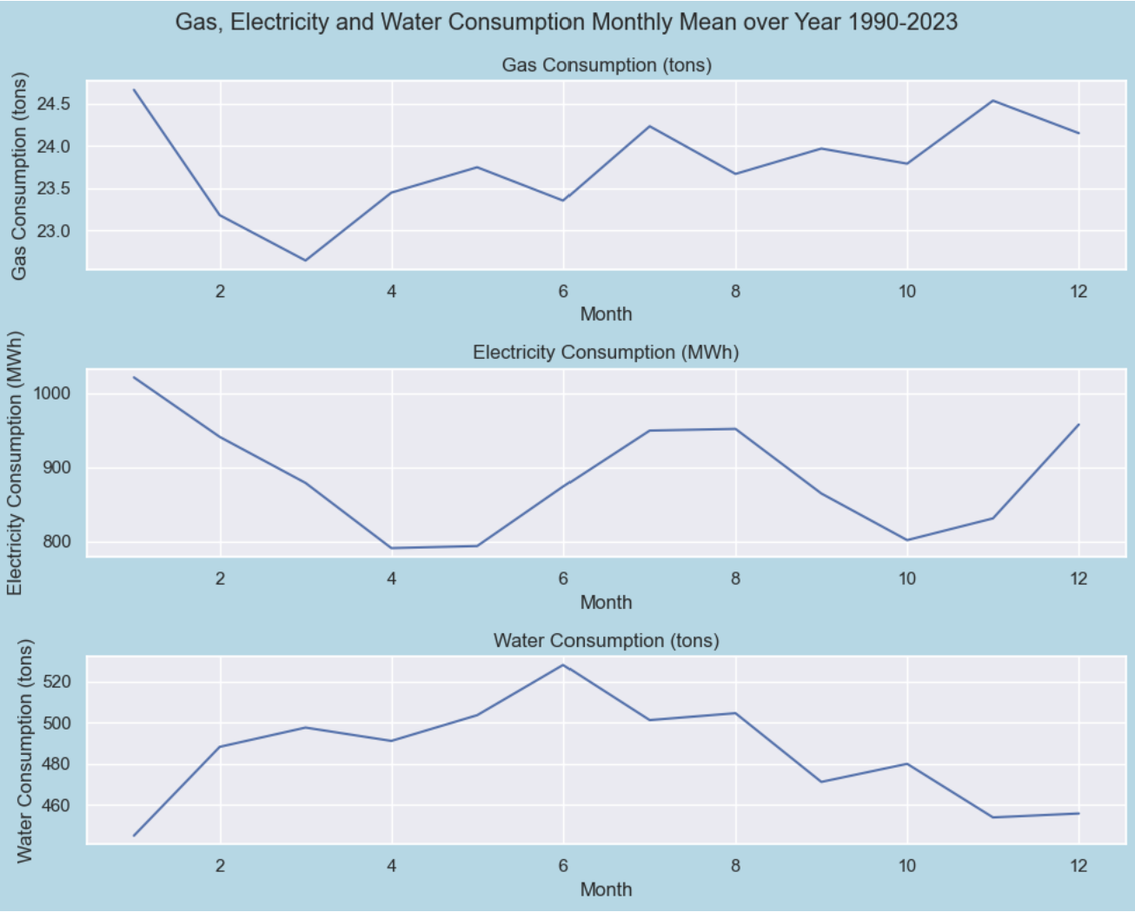
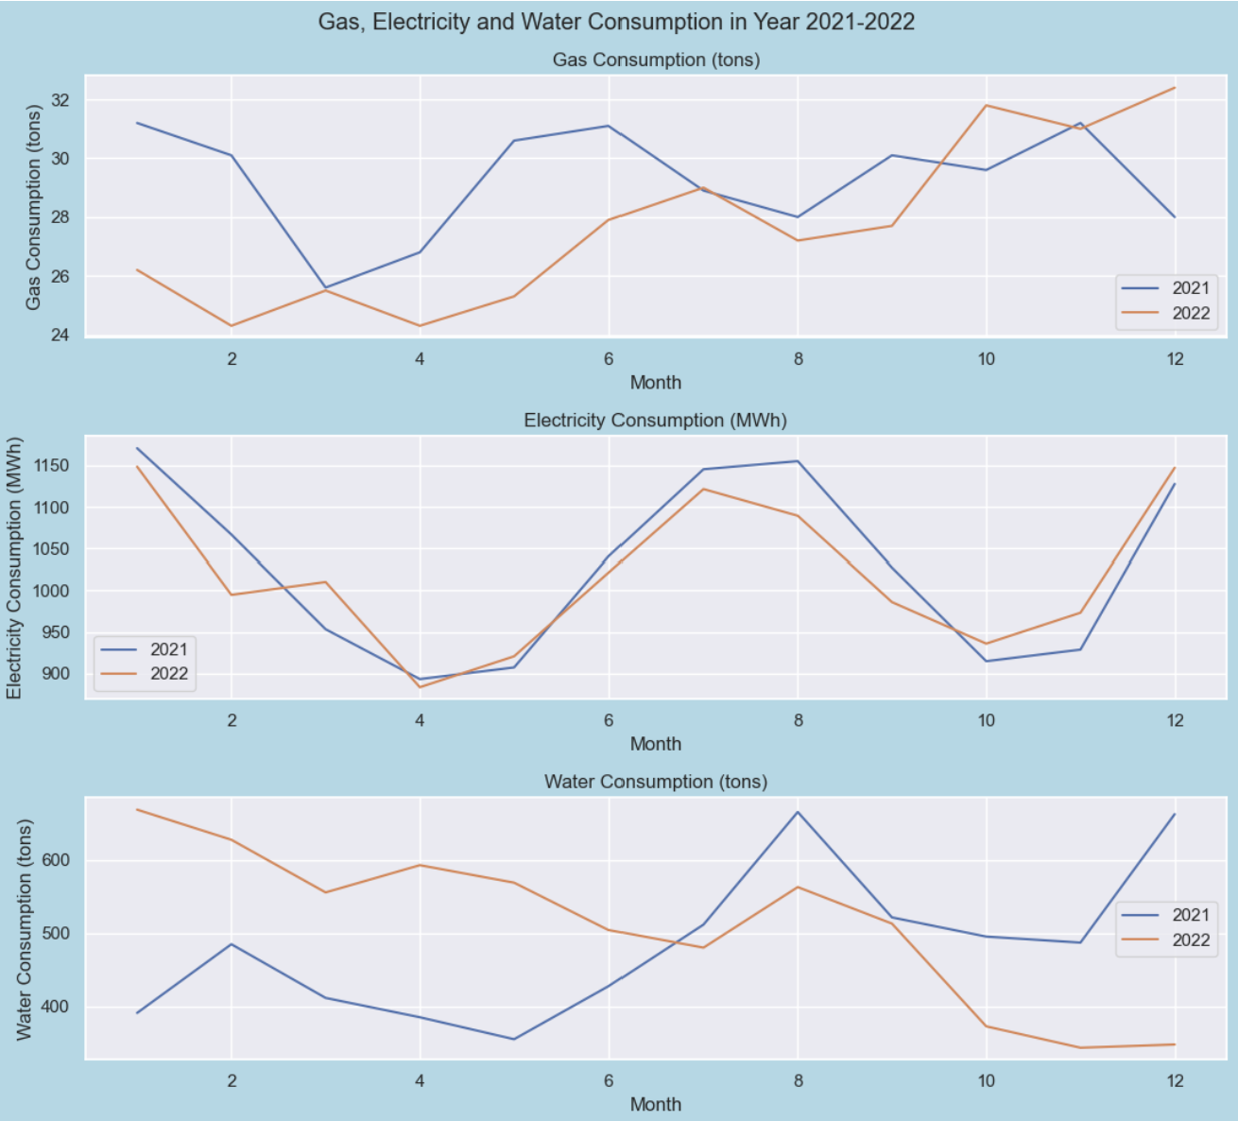
Data Exploration
From the graph above,
Gas Consumption and Electricity Consumption tend to peak in January
Water Consumption is highest in June.
From the graph above, it provides data in recent years 2021 and 2022. Electricity and Water Consumption usually peaks in August

Slide 4
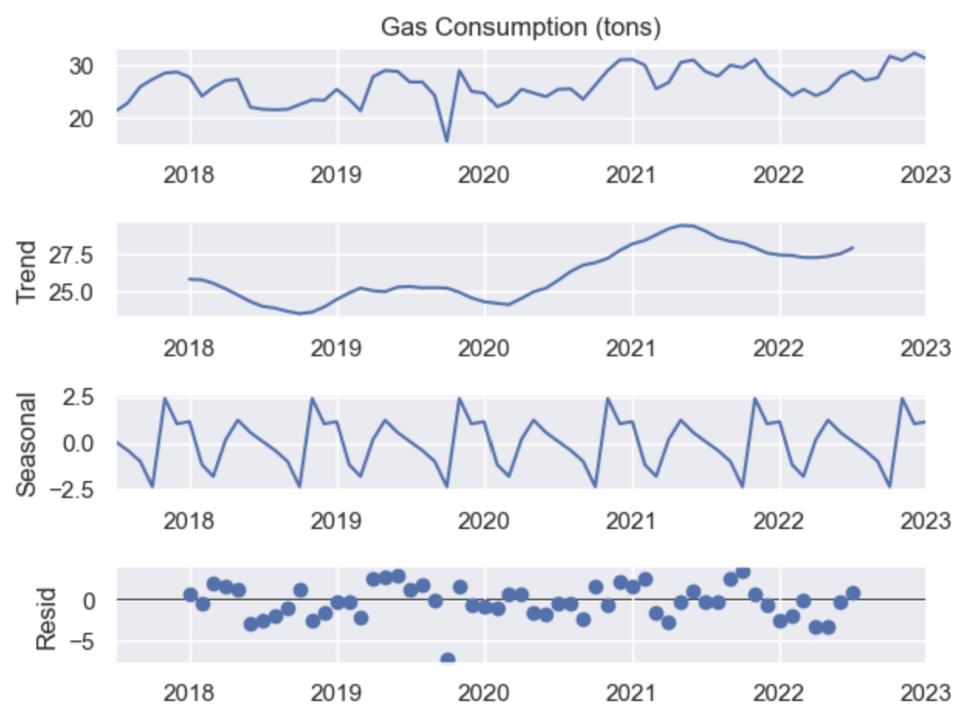
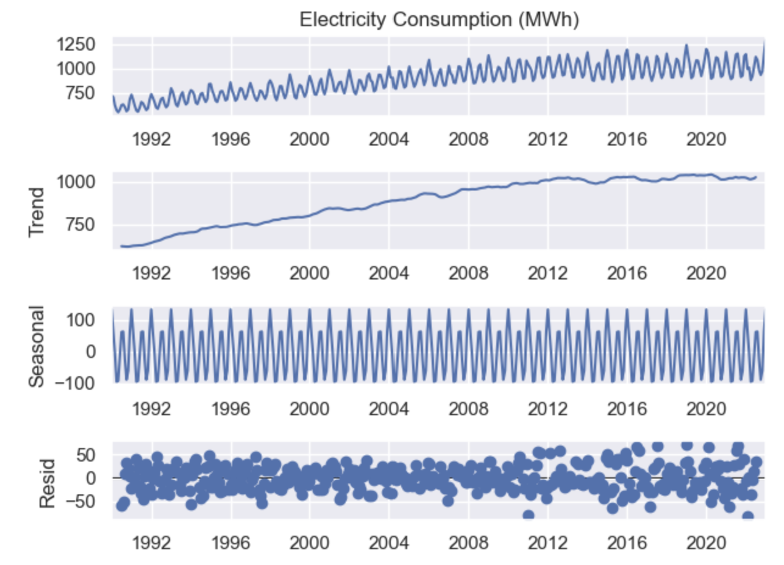
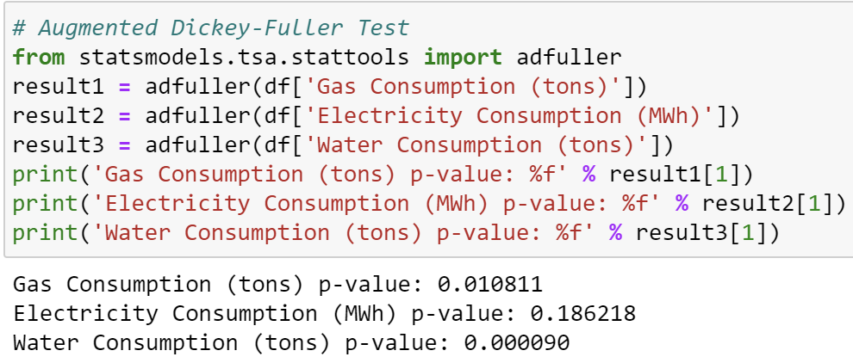
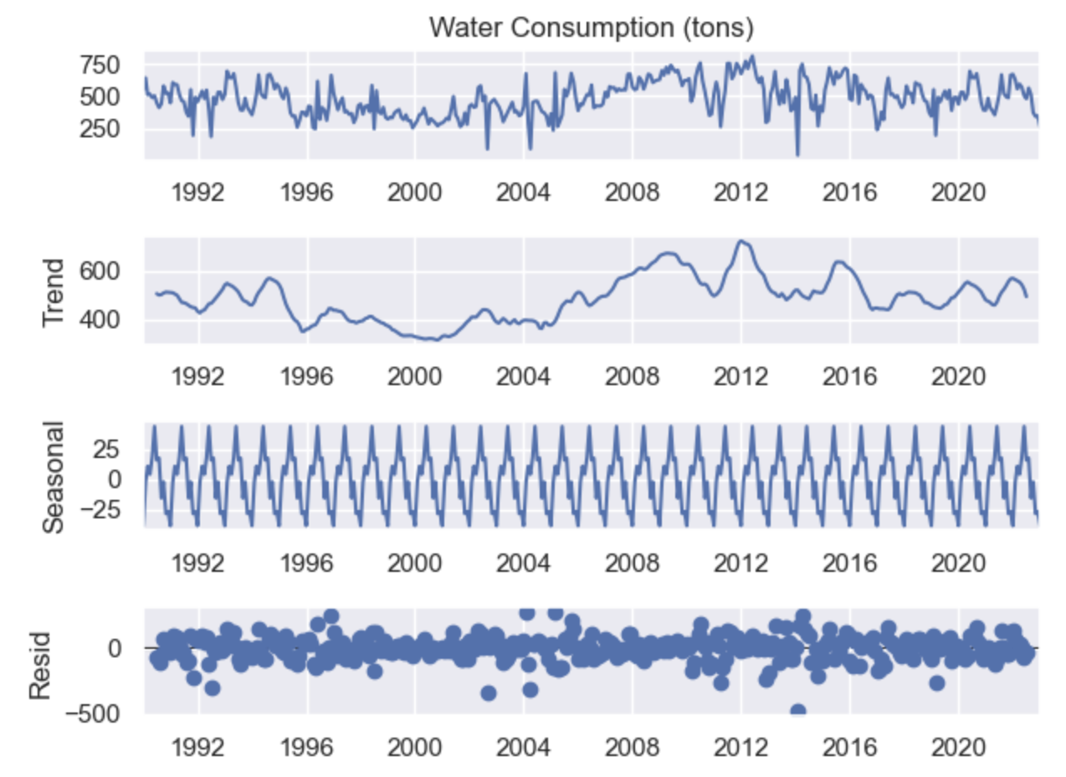
Stationarity
Seasonal Decomposition
H0: The time series can be represented by a unit root, that is not stationary.
H1:The time series is stationary
Gas Consumption (tons) p value is 0.010811 which is < 0.05. Reject the null hypothesis (H0), the data does not have unit root and is stationary
Electricity Consumption (MWh) p value is 0.186218 which is > 0.05. Fail the reject the null hypothesis (H0), the data has a unit root and is non-stationary.
Water Consumption (tons) p value is 0.000090 which is < 0.05. Reject the null hypothesis (H0), the data does not have unit root and is stationary
Electricity Consumption is differenced in order to make the time series stationary.
- Seasonal Period observed every 12 months

Slide 5
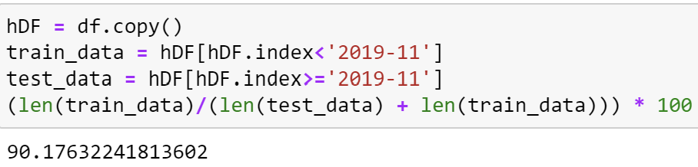
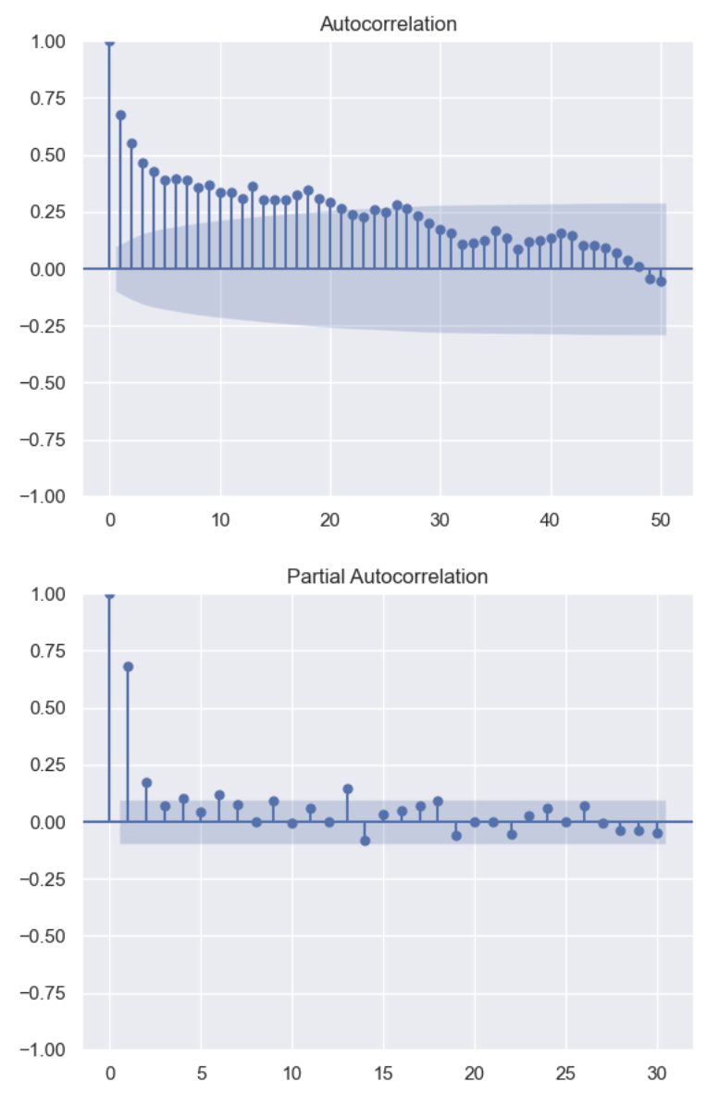
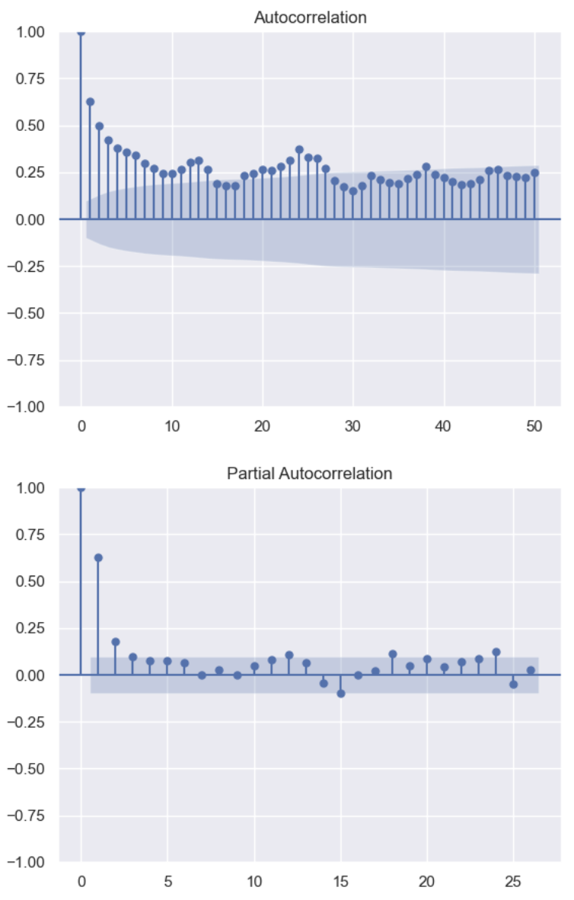
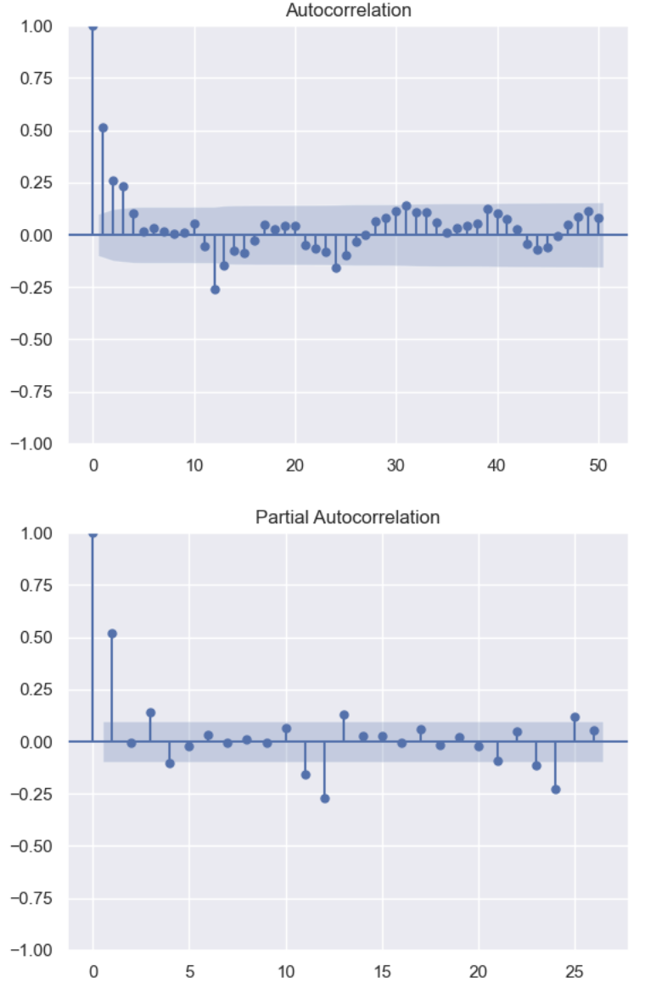
ACF and PACF Plots
An 90:10 ratio between training and test data is chosen where data before Year 2019-11 is used for training and data from Year 2019-11 is used for testing
Gas Consumption (tons)
Water Consumption (tons)
Electricity Usage (MWh)
Gas Consumption and Water Consumption: Tail off at ACF Plot, which indicates an AR model. From PACF plot, cut off happens at lag 2. This illustrates an AR(2) model
Electricity Consumption: Tail off at ACF Plot, which indicates an AR model. From PACF plot, cut off happens at lag 1. This illustrates an AR(1) model

Slide 6
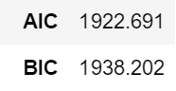
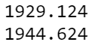
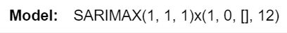
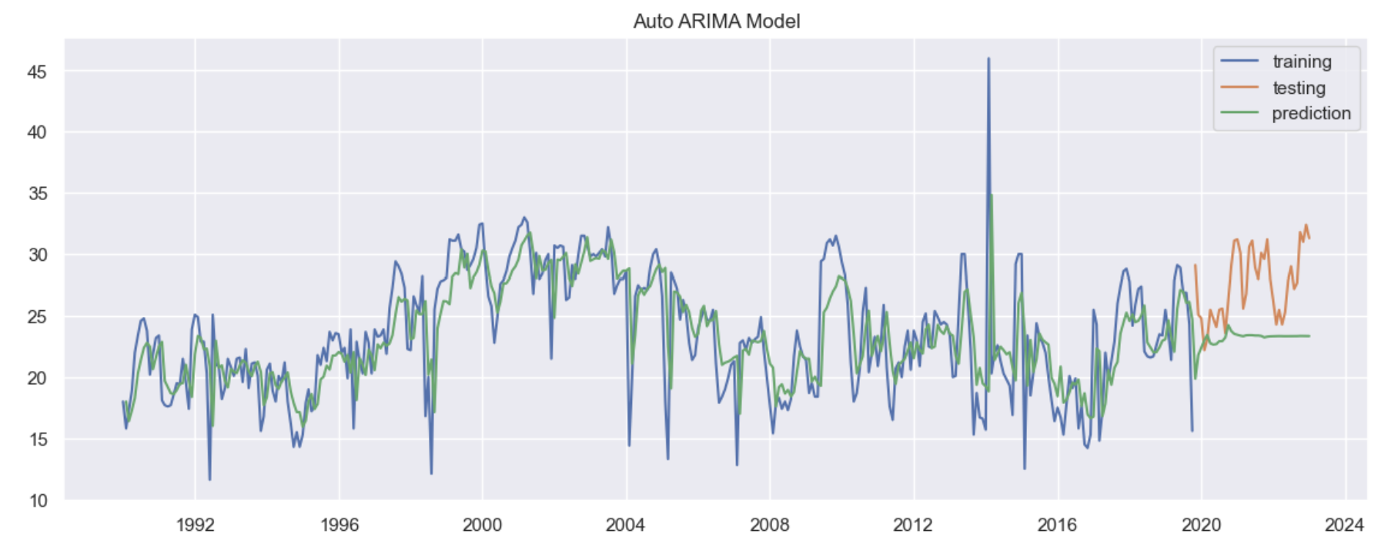
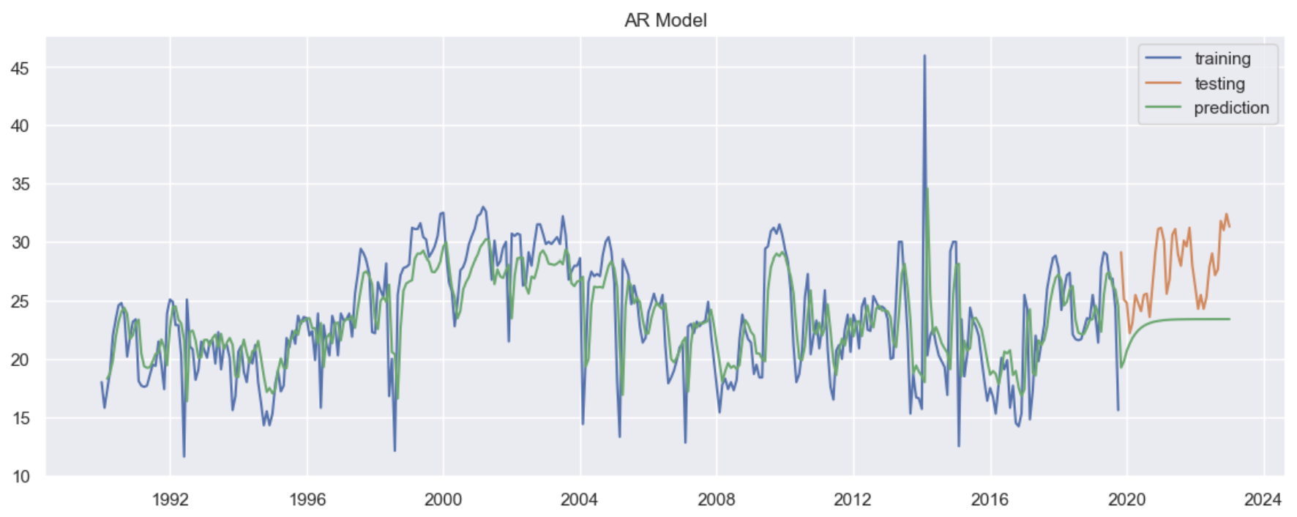
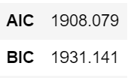
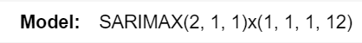
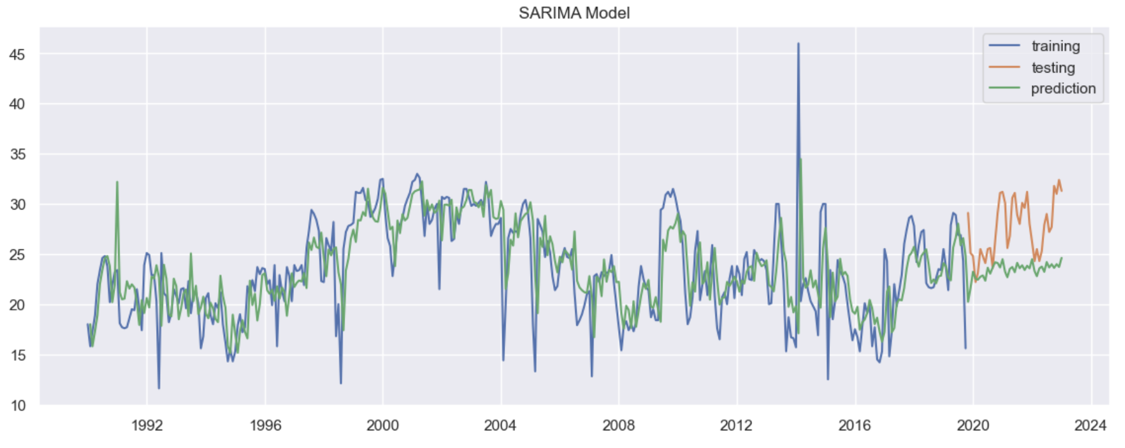
Modelling (Gas Consumption)
Auto ARIMA Model
AR(2) Model
AIC:
BIC:
Model:
First, I fitted an Auto ARIMA model to find the most ideal parameters as a starting point.
Secondly, I implemented a SARIMA model and an AR model. I attempted to log transform the data but there was no improvement to the MAPE.
Since our SARIMA model has the lowest AIC and BIC as well as the lowest MAPE, we will further improve our model by finding the best order and seasonal order for it.
SARIMA Model

Slide 7
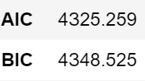
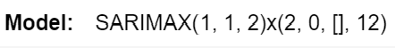
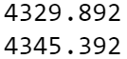
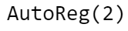
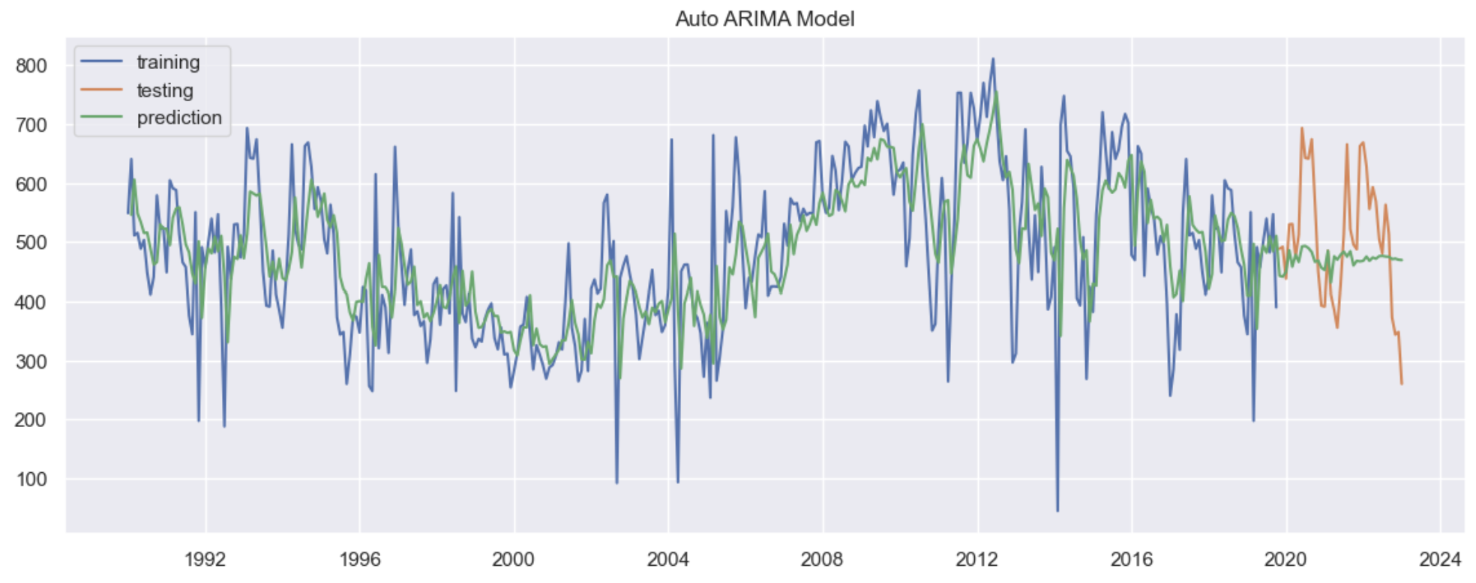
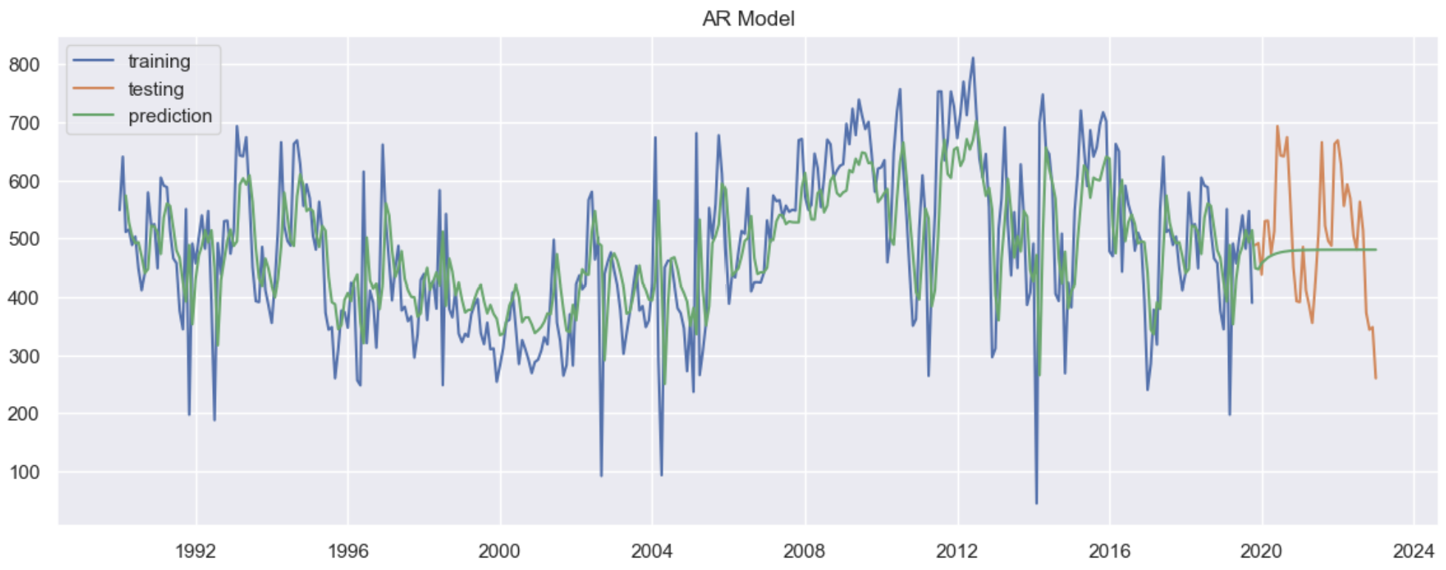
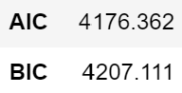
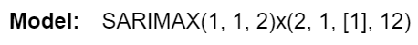
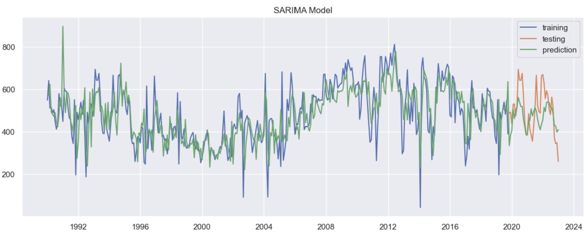
Modelling (Water Consumption)
Auto ARIMA Model
AR(2) Model
AIC:
BIC:
Model:
SARIMA Model
First, I fitted an Auto ARIMA model to find the most ideal parameters as a starting point.
Secondly, I implemented a SARIMA model with exogenous variables (gas) and an AR model. Exogenous variables are external factors that might indirectly affect water’s time series.
Since our SARIMA model has the lowest AIC and BIC as well as the lowest MAPE, we will further improve our model by finding the best order and seasonal order for it.

Slide 8
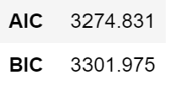
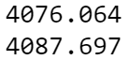
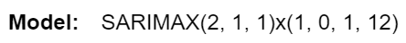
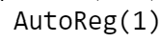
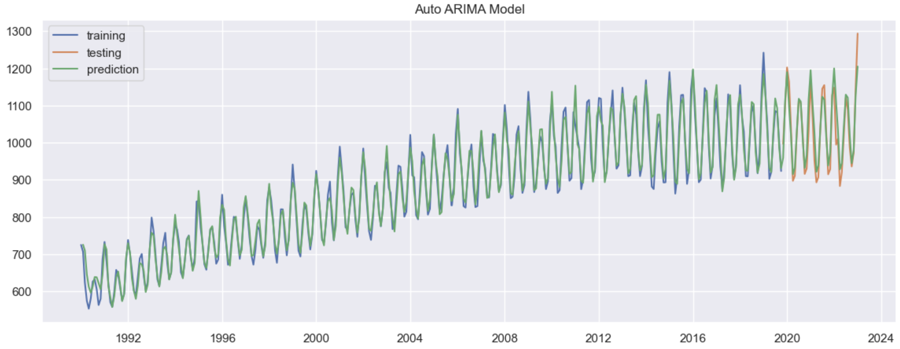
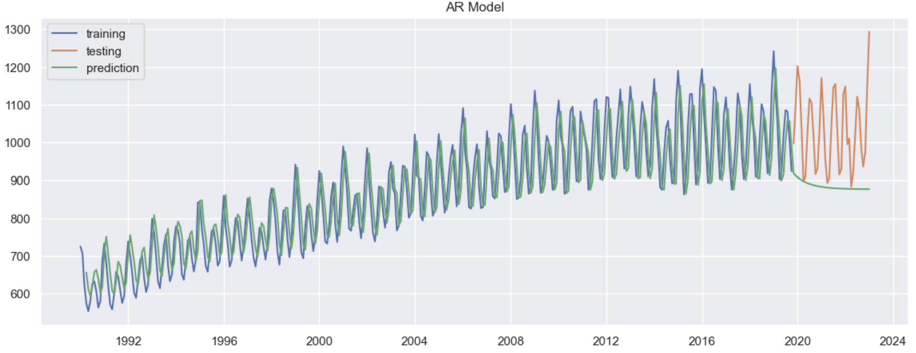
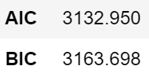
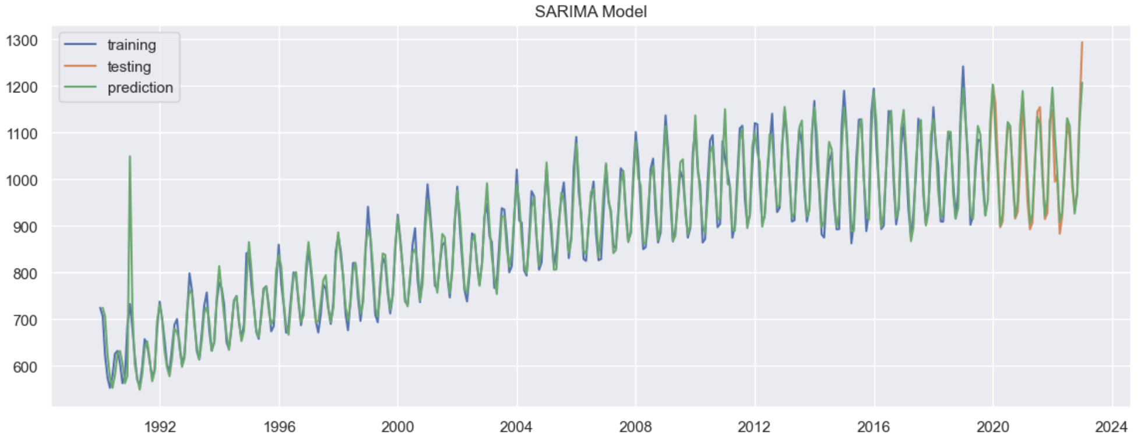
Modelling (Electricity Usage)
Auto ARIMA Model
AR(1) Model
AIC:
BIC:
Model:
SARIMA Model
First, I fitted an Auto ARIMA model to find the most ideal parameters as a starting point.
Secondly, I implemented a SARIMA model and an AR model.
Since our SARIMA model has the lowest AIC and BIC as well as the lowest MAPE, we will further improve our model by finding the best order and seasonal order for it.

Slide 9
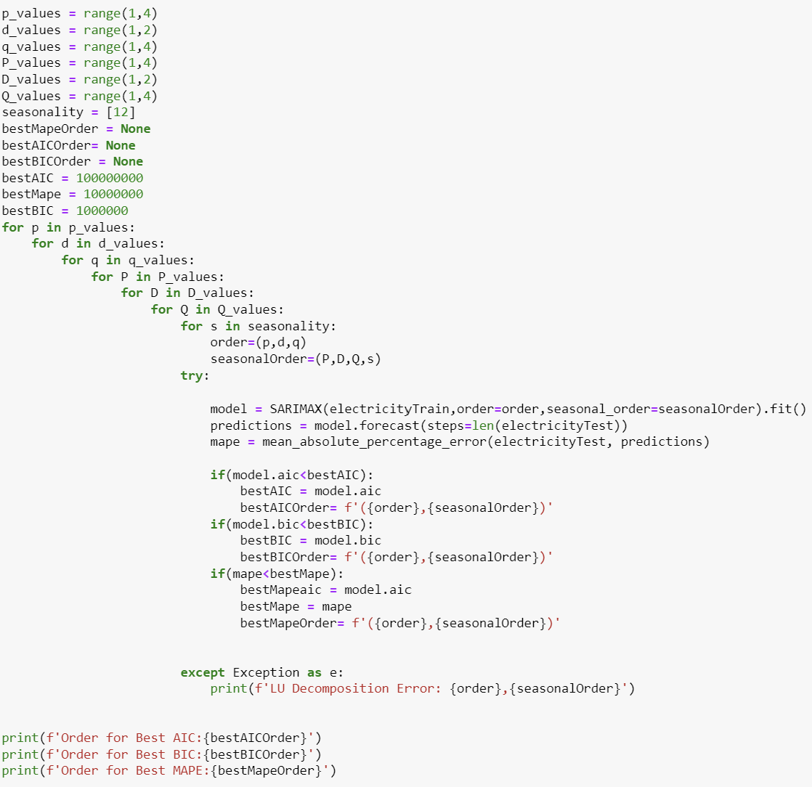
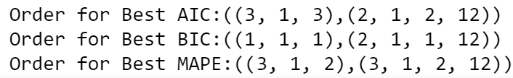
‘For’ Loop Function
I made a for loop to further improve my model and find the best possible order for lowest AIC,BIC and MAPE.
Output:

Slide 10
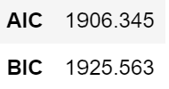
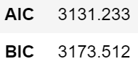
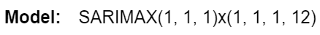
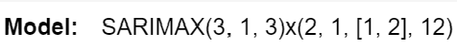
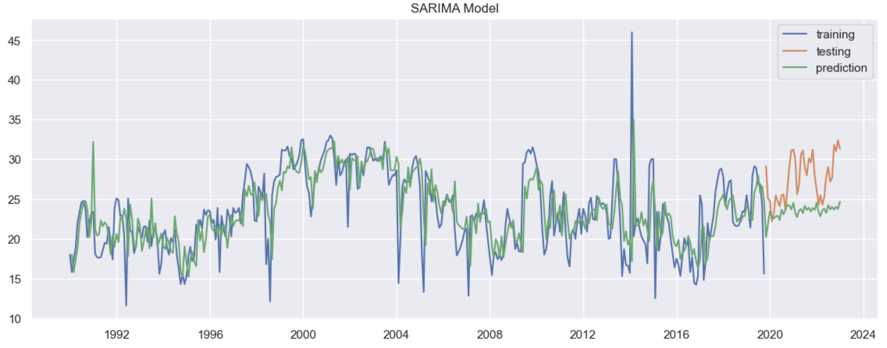
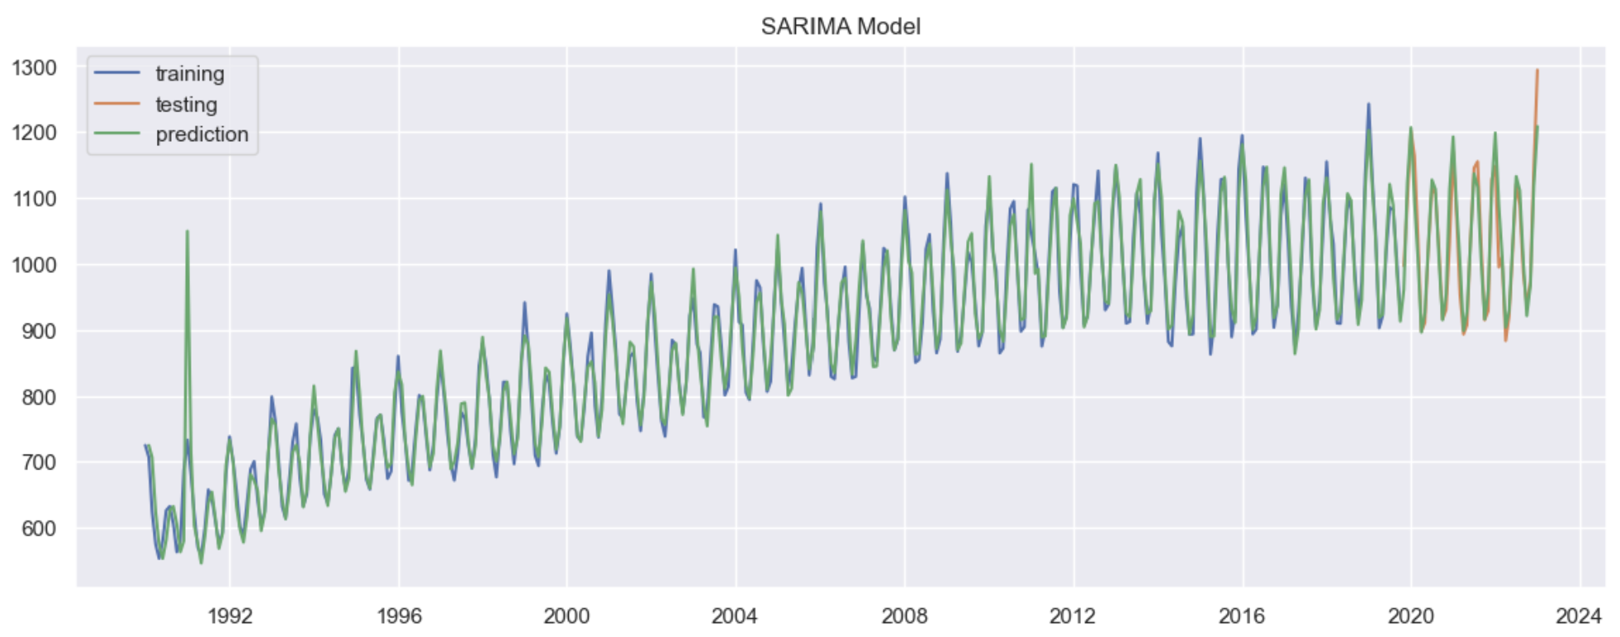
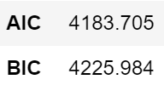


Final Model (Improved)
Gas Consumption (SARIMA Improved)
Electricity Usage (SARIMA Improved)
Water Consumption (SARIMA Improved)
For model improvement, I made a for loop function to find the best order of every SARIMAX Model
For Gas Consumption, the AIC dropped from 1908 to 1906 and BIC dropped from 1931 to 1925. The MAPE on test data decreased by 0.20% from 14.45% to 14.25%.
For Water Consumption, although the AIC increased from 4176 to 4183 and BIC increased from 4207 to 4225. The MAPE on test data decreased by 0.25% from 15.52% to 15.15%. Upon weighing the trade-off between model complexity and accuracy, I will prioritise a lower MAPE as it reflects a more accurate prediction to the real world.
For Electricity Usage, the AIC decreased from 3132 to 3131 and BIC increased from 3163 to 3173. The MAPE decreased by 0.09% from 2.40% to 2.31%

Slide 11
Conclusion
Final Model Chosen: Gas Consumption: SARIMAX(1,1,1)x(1,1,1,12)
Water Consumption: SARIMAX(2,1,3)x(2,1,2,12)
Electricity Consumption: SARIMAX(3,1,3)x(2,1,2,12)
My electricity consumption forecast is the most accurate with the lowest MAPE score of 2.14% on training data and 2.31% on testing data. Compared to the exponential smoothing that was used as a baseline, my MAPE has decreased significantly which implies that my model is more accurate when forecasting.
All in all, this time series project has allowed me to learn more in-depth about forecasting a time series and how forecasting is important for decision-makers to make the best decision
Exponential Smoothing (Used as Baseline)
Gas:
Water:
Electricity:

